Slide 1

IN432
Advanced Web Programming

Slide 2
Lecture Outline:
Domain name, hosting, DNS and search engine optimization.
Installing Visual studio code
Creating your first .html file
Main elements: DOCTYPE, html, head and body sections.
Heading elements, paragraph, division, span, comment.

Slide 3
Domain name, hosting, DNS and search engine optimization.
What is a Domain Name?
A domain name is your website name.
A domain name is the address where Internet users can access your website.
A domain name is used for finding and identifying computers on the Internet. Computers use IP addresses, which are a series of number. However, it is difficult for humans to remember strings of numbers. Because of this, domain names were developed and used to identify entities on the Internet rather than using IP addresses.

Slide 4
Domain name, hosting, DNS and search engine optimization.
What is a Domain Name?
A domain name can be any combination of letters and numbers, and it can be used in combination of the various domain name extensions, such as .com, .net and more.
The domain name must be registered before you can use it.
Every domain name is unique. No two websites can have the same domain name. If someone types in www.yourdomain.com, it will go to your website and no one else’s.
The price of a domain name typically runs between $15-25 per year.

Slide 5
Domain name, hosting, DNS and search engine optimization.
What is Hosting?
Web hosting is the place where all the files of your website live.
When someone enters your domain name in a browser, the domain name is translated into the IP address of your web hosting company's computer. This computer contains your website's files, and it sends those files back to the users' browsers.
What is a DNS (Domain Name Server) ?
DNS servers translate domain names into IP addresses, making it possible for DNS clients to reach the origin server.

Slide 6
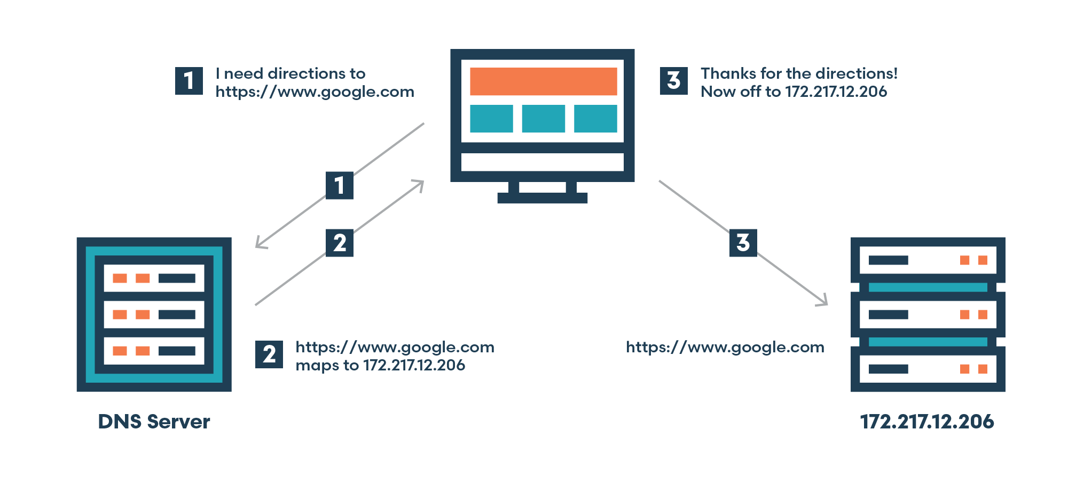
Domain name, hosting, DNS and search engine optimization.

Slide 7
Domain name, hosting, DNS and search engine optimization.
What is Search Engine Optimization SEO?
In simple terms, it means the process of improving your site to increase its visibility for relevant searches. The better visibility your pages have in search results, the more likely you attract prospective and existing customers to your business.

Slide 8
Installing IDE Visual Studio code
You can download VS Code form the following link:
https://code.visualstudio.com/download

Slide 9
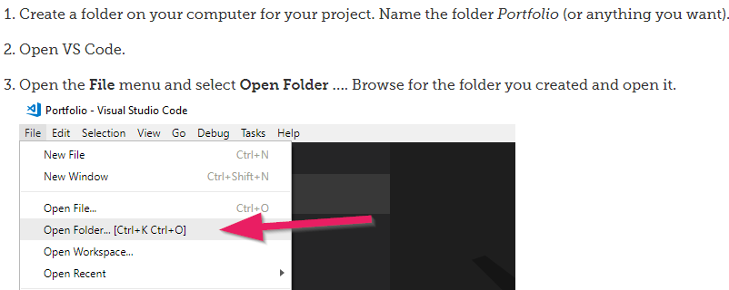
Creating your first .html file
Editor? For creating web pages, a normal text editor would be sufficient, it is recommend that you use a modern code editor like VS Code.

Slide 10
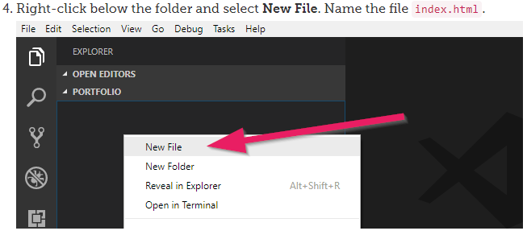
Creating your first .html file

Slide 11
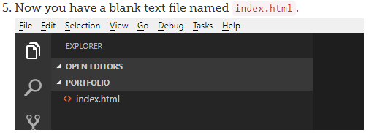
Creating your first .html file
Why index.html?
The index.html file is automatically displayed first.

Slide 12
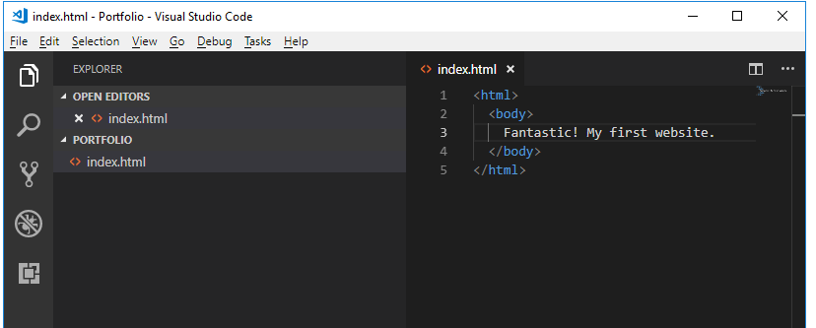
Creating your first .html file
Viewing and Refreshing
Type the following code in your index.html file.

Slide 13
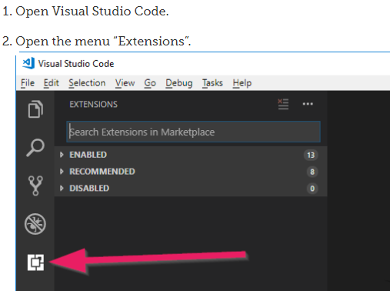
Creating your first .html file
Viewing and Refreshing
To view the output of your file index.html
you can do one of the following:
1- install an extension for VS code (Live Server )
as follows:

Slide 14
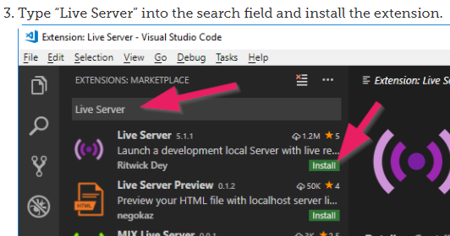
Creating your first .html file
Viewing and Refreshing

Slide 15
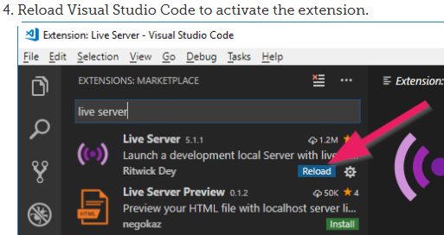
Creating your first .html file
Viewing and Refreshing

Slide 16
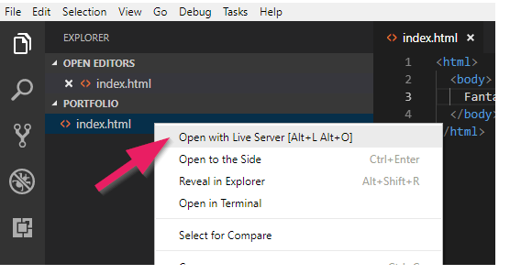
Creating your first .html file
Viewing and Refreshing
Right Click on the file
index.html and select
Open with Live Server

Slide 17
Structure of a Web Page
What is HTML?
HTML stands for Hyper Text Markup Language
HTML is the standard markup language for creating Web pages
HTML describes the structure of a Web page
HTML consists of a series of elements
HTML elements tell the browser how to display the content
HTML elements label pieces of content such as "this is a heading", "this is a paragraph", "this is a link", etc.

Slide 18
A Simple HTML Document
<!DOCTYPE html>
<html>
<head>
<title>Page Title</title>
</head>
<body>
-----
-----
</body>
</html>

